Slide 1

Basic Word Processor
GROUP H:
Daryl Winslow
Adam Noonan
Marcel Schilsky
Stephen Pollard

Slide 2
The Project Problem
User Requirements:
What does the user want?
A word processor!
Open/Save/Edit Files
Cut/Paste/Word Count/Different Font Styles

Slide 3
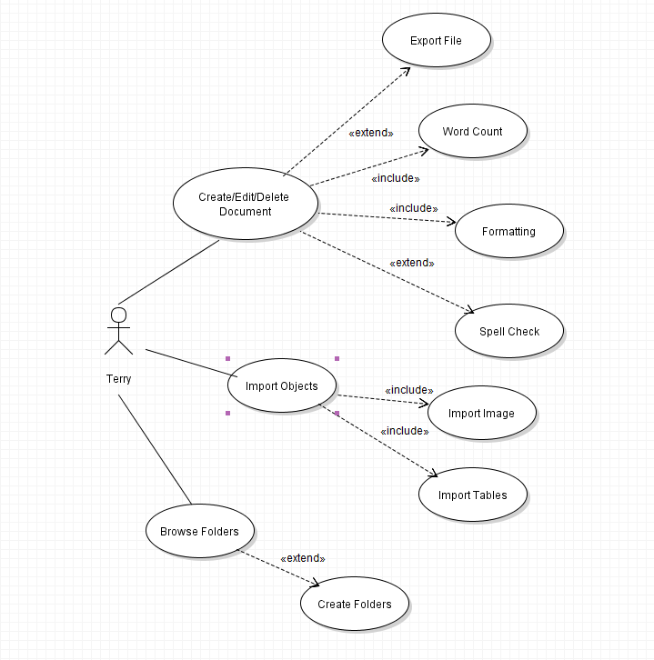
Sample Use Case:

Slide 4
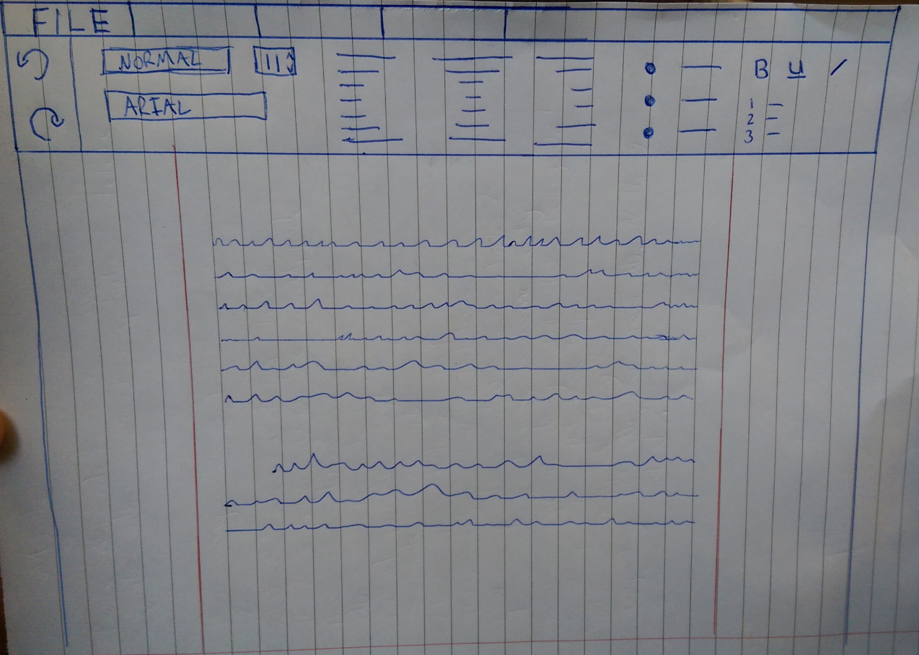
Initial Prototype

Slide 5
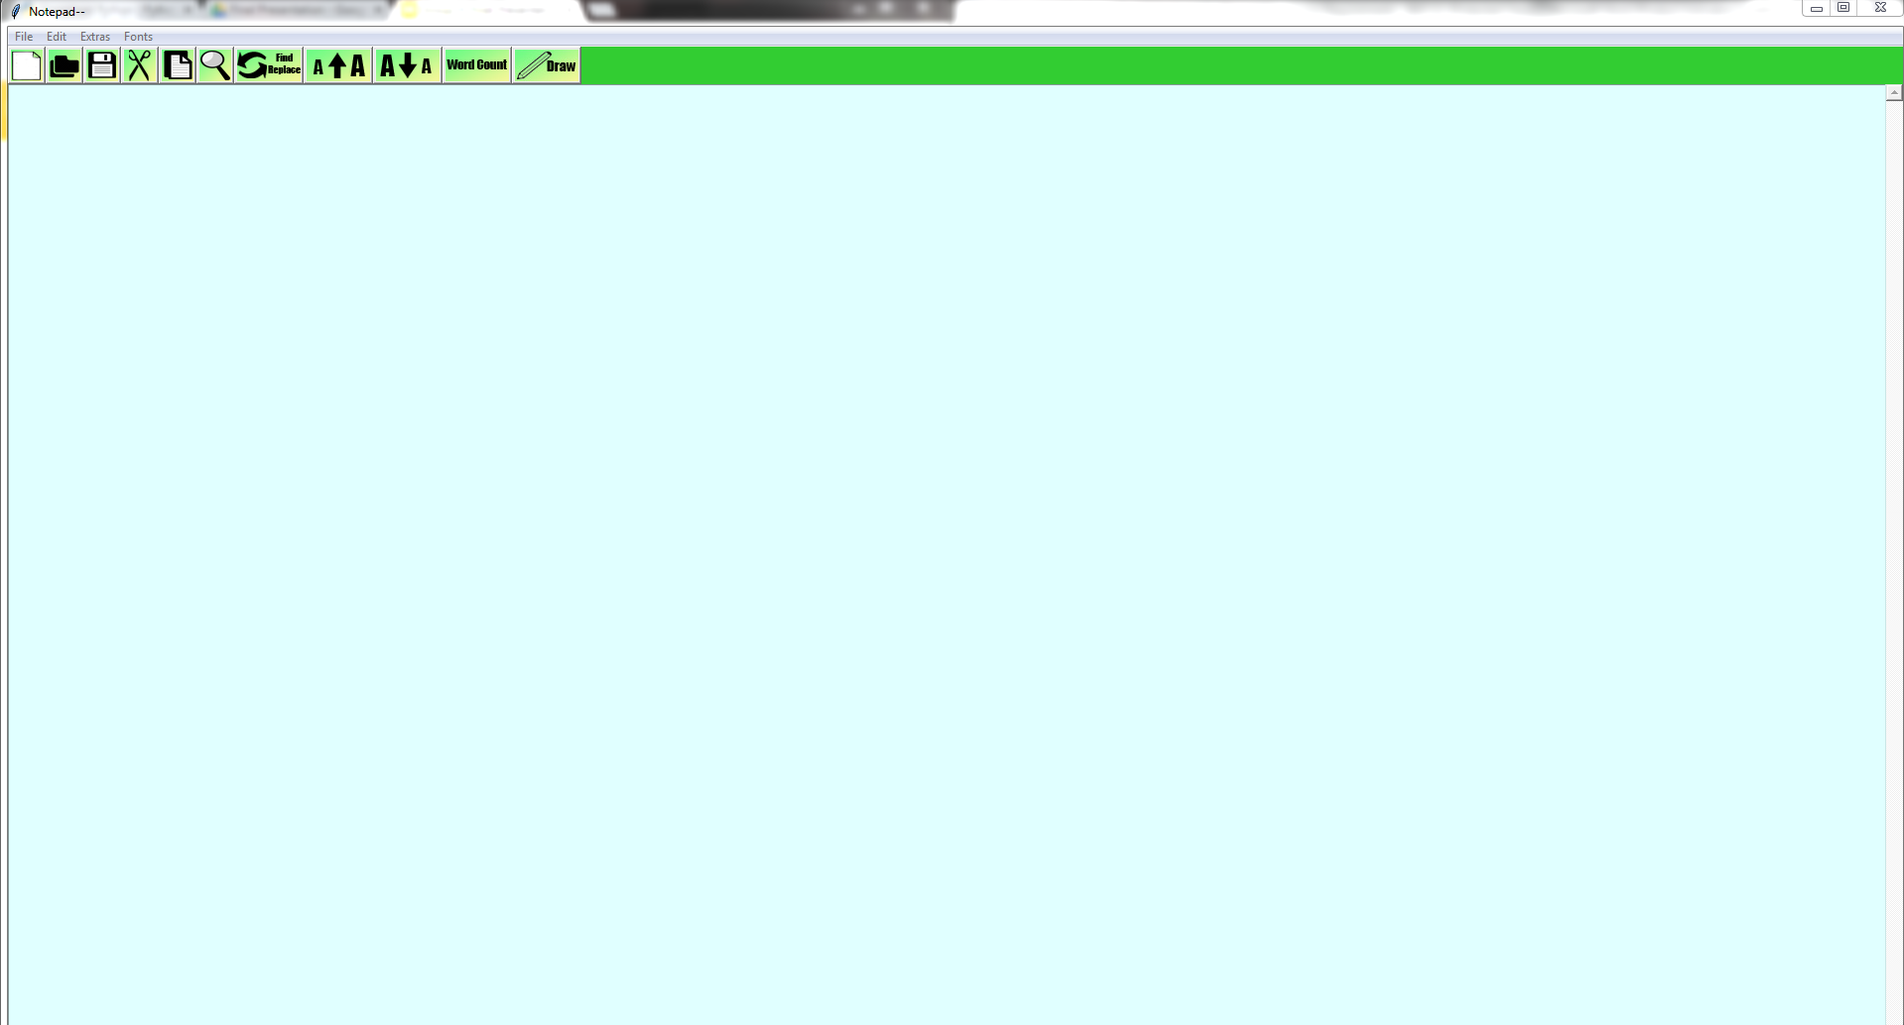
End Product

Slide 6
Design Plan
We intended to make the user interface as simple and intuitive as possible.
We applied the Agile Software Development Method.
We reassessed our design every week and made changes to react to coding problems and new features we found.

Slide 7
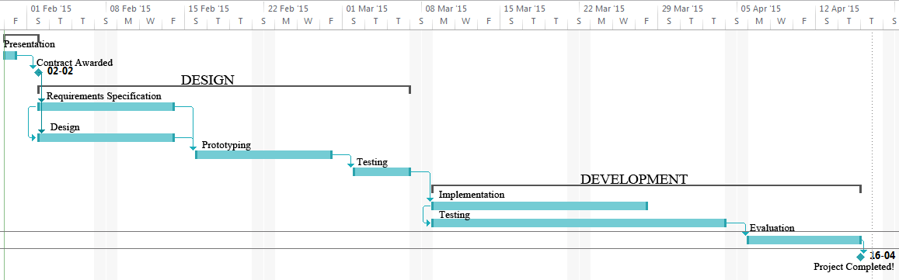
Gantt Chart

Slide 8
Implementation
Team was very successful in implementing the design
All members worked together well
Decisions were made democratically
Disputes were resolved without violence or use of bad language

Slide 9
Testing
Regular testing was carried out every week
Test cases were created before coding began on each new feature
Every new feature that was implemented was thoroughly tested by all team members

Slide 10
Conclusions:
Benefits of Team Working
Different team members bring unique skills to the group allowing more complex problems to be solved
More can be achieved by working in a group. Four heads are better than one
We learned new skills from each other

Slide 11
Conclusions:
Downside of Team Working
Social loafing. Sometimes a team member may feel that “someone else” will do all the work for them
Misunderstandings. Poor communication can lead to wasted time when team members end up doing the same tasks simultaneously
Hurt feelings

Slide 12
What Would we do Differently?
Keep better version histories
More team meetings
Make better design plans
Divide tasks more efficiently among the group

